Slide 1
RoboCAT
Dalton Hirst
Avinash Tiwari
Toan Chu

Slide 2
Outline
Requirements
Approach
Hardware
Software
Deliverables/Conclusion

Slide 3
Requirements

Slide 4
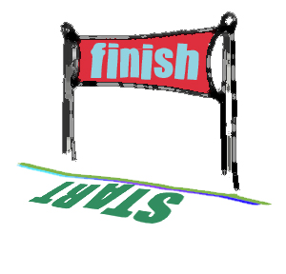
Requirements for RoboCAT
Part 1:
Follow a line
The robot should follow the black tape
Return to start after touching Finish Line
Should be autonomous

Slide 5

Requirements for RoboCAT
Part 2:
Our sensor has to work
Sense the presence of other robots on the path
Know its surrounding
Beware of the walls…they can be dangerous
Sense and avoid any other object that can cause problems

Slide 6

Requirements for RoboCAT
Part 3:
Win the Race (get most of the points)
Losing is not an option!

Slide 7
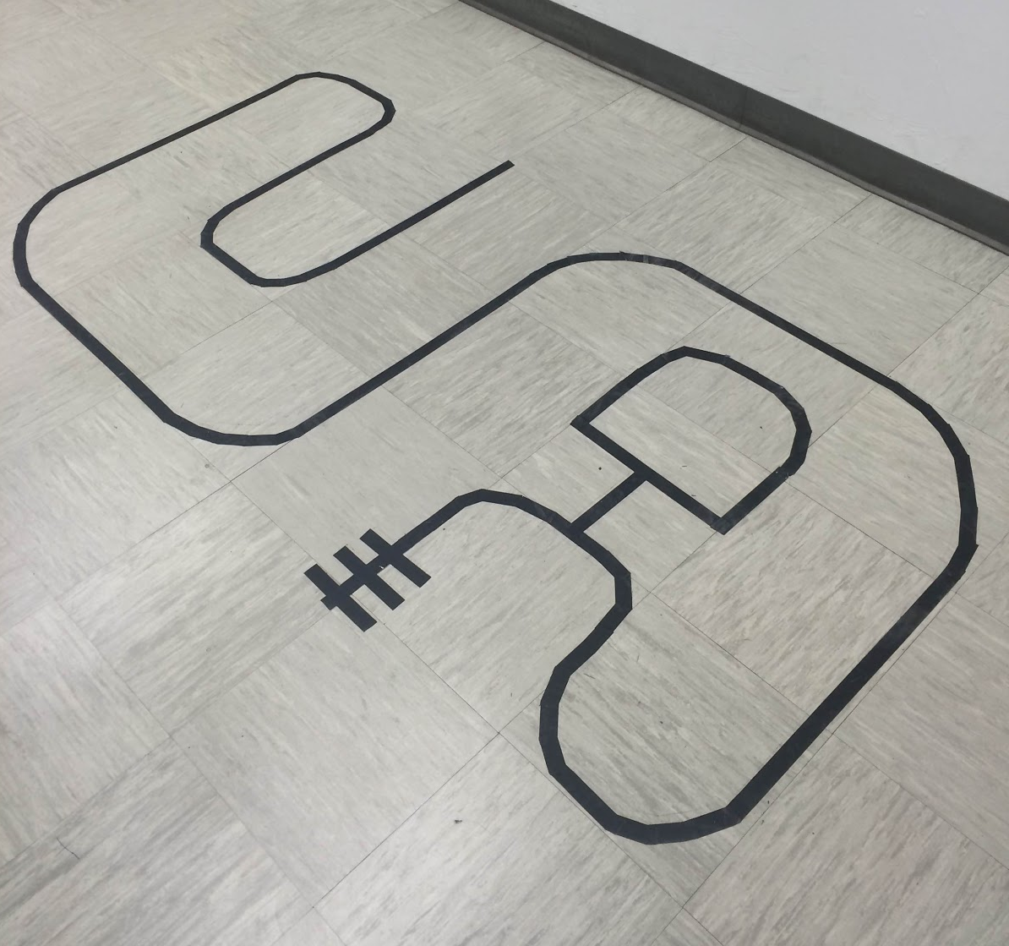
The Course
The Start Line
Starting Point for the Robot
Finish Line/Turn around spot
End Line and Robot turns around here
Extra Credit Loop
Enter and Exit out of this loop secondary obstacle

Slide 8
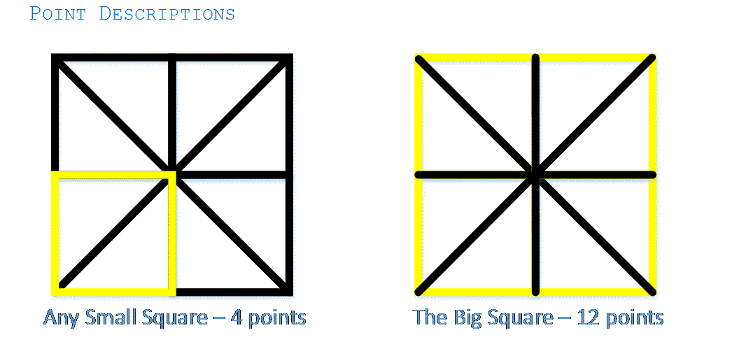
The Course

Slide 9
Approach
Orientation of the sensors was key to the success of our design.
When the robot turns left,
the right sensor will sense the
black tape and indicate to the
robot to turn right.
When the robot turns right,
the left sensor will sense the
black tape and indicate to the
robot to turn left.

Slide 10
Approach: Continued
Orientation of the Infrared Transmitter and Phototransistor under the chassis of the Robot.

Slide 11
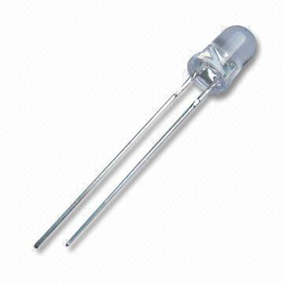
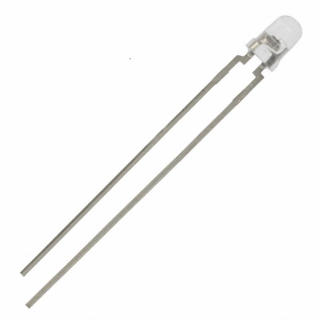
Approach: Continued
The combination of the Infrared Transmitter and Receiver allowed us to determine when the robot is on or off the black tape.

Slide 12
Hardware

Slide 13
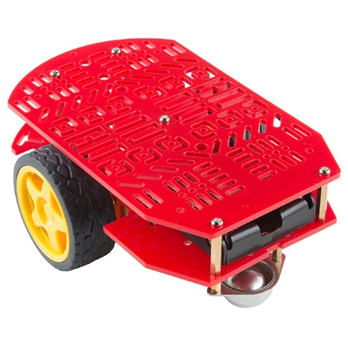
Hardware
Robot Chassis
Robot Chassis
Basic Robot Build
Infrared Transmitter
Infrared Receiver (Photo-resistor)
Wire 22-guage (for wire wrap)
Assembling tools
Screw Drivers, nuts, bolts, solder-machine, Wire wrap Screw etc.
Motors
Wheels
Chargeable Power Supply
Infrared Transmitter
Photo-Resistor

Slide 14
Block Diagram
Power Supply 5V
IR Transmitter
IR Transmitter
IR Transmitter
PIC32MX470F512L
IR Receiver
PWM
4 Channels
IR Receiver
H-Bridge
Motor controller
Left Motor
IR Receiver
Right Motor

Slide 15
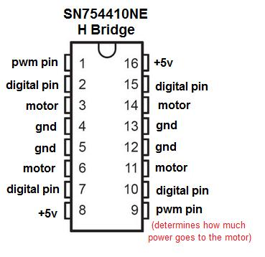
Schematics: H-Bridge

Slide 16
Schematics: LCD

Slide 17
Schematics: Complete Circuit

Slide 18
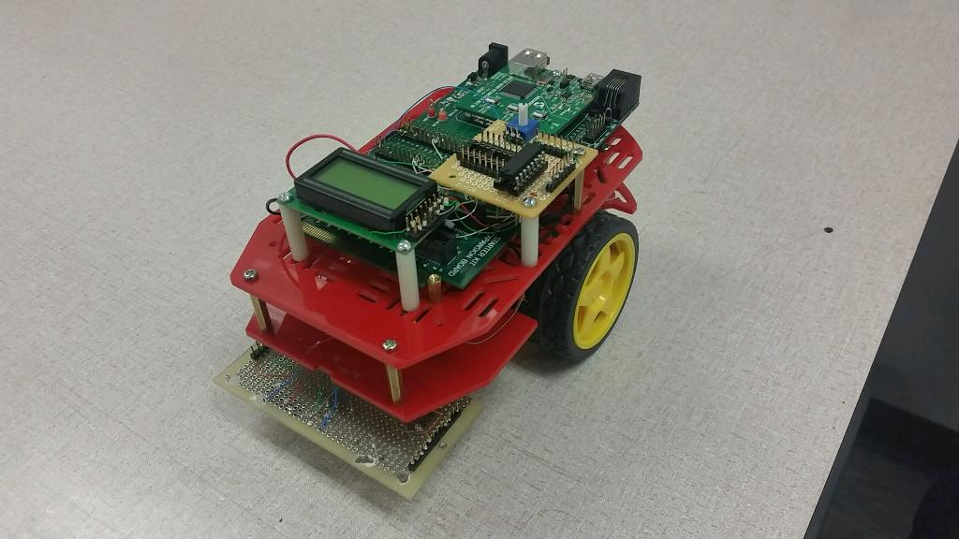
The eye-catching RoboCAT

Slide 19
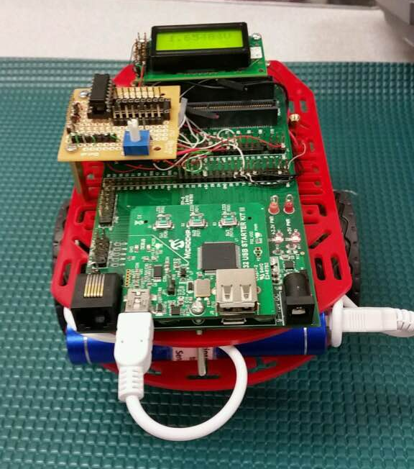
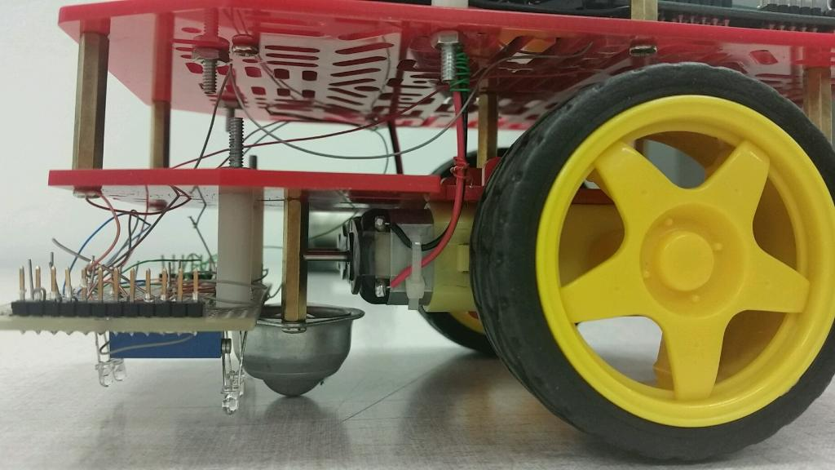
The eye-catching RoboCAT

Slide 20
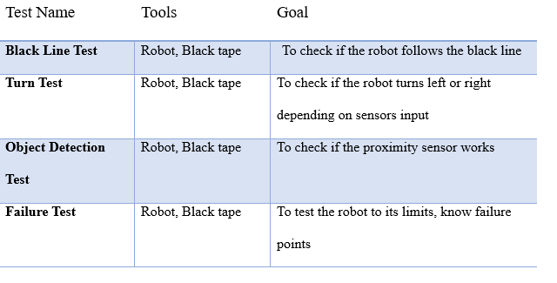
Testing

Slide 21

Software
Finite-State Machine
Analog-to-Digital Convertor
Pulse-Width-Modulation (PWM)
Line following algorithm
MPLAB!

Slide 22
Finite State Machine to follow the line

Slide 23
Line following algorithm Detailed Explanation
This Finite State Machine allowed us to account for different cases.
Case 1:
If only the center sensor under the chassis of the robot senses tape the robot will stay in the “Go Straight State” and continue until the sensors register different information.
Case 2:
If there robot turns too far right, the left sensor under the robot would register black tape and the state would change from the “Turn Right State” to the “Turn Left State” where the wheels would adjust to turn left.
Case 3:
If there robot turns too far left, the right sensor under the robot would register black tape and the state would change from the “Turn Left State” to the “Turn Right State” where the wheels would adjust to turn right.

Slide 24
Software: Detailed Explanation
Case 4:
If there robot registers all three sensors reading black tape, the robot changes from its current state to the “Turn Around State”.
Case 5:
If the sensors register no information (or can’t find any black tape) the robot enters a “Look for Tape” state where it does clockwise turns until it registers black tape at any sensor, then changes states accordingly.

Slide 25
Deliverables
Deliverables
PDR and CDR
Demo
Able to follow lines on the ground and the inner loop for extra credit
Final Report

Slide 26
Conclusion
Problem: Make the robot follow the line, go through extra loop and return on the same path
Approach:
Simple and organized hardware
Use of Finite-State Machine in programming
What did we learn from this?
Troubleshooting unexpected problems
Team work, collaborating with other’s ideas

Slide 27
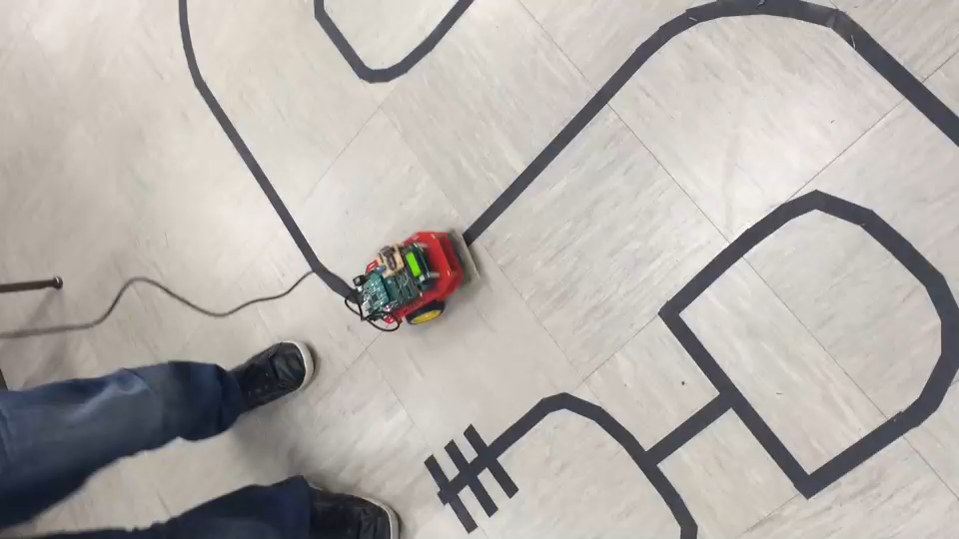
RoboCAT in Action!!

